Slide 1


AIR QUALITY INDEX AUTOMATION, STATISTICAL ANALYSIS & FORECASTING
By: Guide:
Palak Goel (21MDT0041) Dr. Jitendra Kumar (15975)
MSc. Data Science
School of Advanced Sciences
Vellore Institute of Technology, Vellore
1

Slide 2

Problem Statement
India is the fifth-most polluted country in the world, and the rapid rise in pollution is having a significant impact on the environment in a number of important cities.
This study will measure air pollution trends and
also evaluate the air quality index with respect
to various geographic locations in order to get
a global perspective of the harm caused by
air pollution and to design suitable methods to
prevent it in the future.
21MDT0041 Palak Goel Master Thesis
2

Slide 3

Problem Statement
The air quality improved during the 2020 COVID shutdown, when all of India was closed, leading to a GOOD air quality index.
But how quickly is it expanding in different parts of
India after the lockdown?
The air quality index is one tool for assessing the
current state of air quality. Six different methods
of calculating the Air quality Index (AQI) based on
the synergistic impacts of the four pollutants PM10,
PM2.5, SO2, and NO2 will be used to compare the existing ambient air quality in
the research area.
21MDT0041 Palak Goel Master Thesis
3

Slide 4
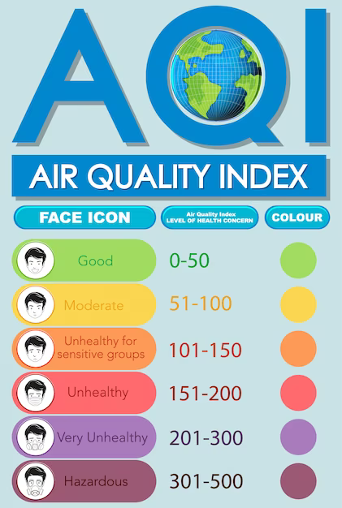
Abstract
In this regard, the Central Pollution Control Board and the Ministry of Environment, Forestry, and Climate Change's data were used to create the polluted database (India). These statistics, which were gathered at several monitoring stations in the cities of India, show the annual growth of SO2, NOx, and particulate matter (PM) 2.5 in 2021.
The findings indicate that multiple transport modes, small- and large-scale power generation (from diesel, coal, and gas plants), industries, constructions, and residential cooking were the sources of SO2, NOx, and PM 2.5.
Overall, India had a trend that was becoming worse every day. According to the findings, that used as a trained dataset for Machine learning algorithms the locations under consideration fell into four categories: critically contaminated (CP), highly polluted (HP), moderately polluted (MP), and low polluted. Using satTScan for finding the cluster or hotspot of pollution.
21MDT0041 Palak Goel Master Thesis
4

Slide 5

Objective
AQI Automation.
Studying which particulate matter(PM10, PM2.5, SO2, and NO2) effecting the air quality for respective states.
Identifying most polluted state and air particulate
prevailing in that region.
Identifying state with good air quality in order to
applying its practices for index improvement.
Visualization over India map.
Hotspot detection.
Predicting air quality on the basis of PM10, PM2.5, SO2, and NO2 values.
21MDT0041 Palak Goel Master Thesis
5

Slide 6
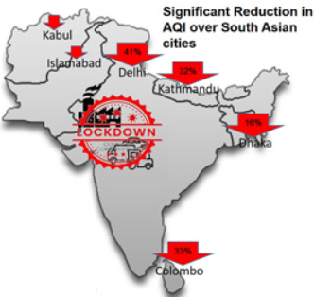
Literature Review
India is one of the most polluted countries in the world, and air pollution is a major problem. According to the World Health Organization (WHO), 13 of the 20 most polluted cities in the world are in India. The major sources of air pollution in India are vehicular emissions, industrial emissions, and burning of crop residues.
A review of the literature on air quality index analysis of states of India indicates that air quality varies significantly across different states in India.
During 2020 covid lockdown when whole India was shut
then the air quality improved resulting in GOOD air quality
index. But after lockdown how vigorously its growing in different geographical
location of India.
21MDT0041 Palak Goel Master Thesis
6

Slide 7
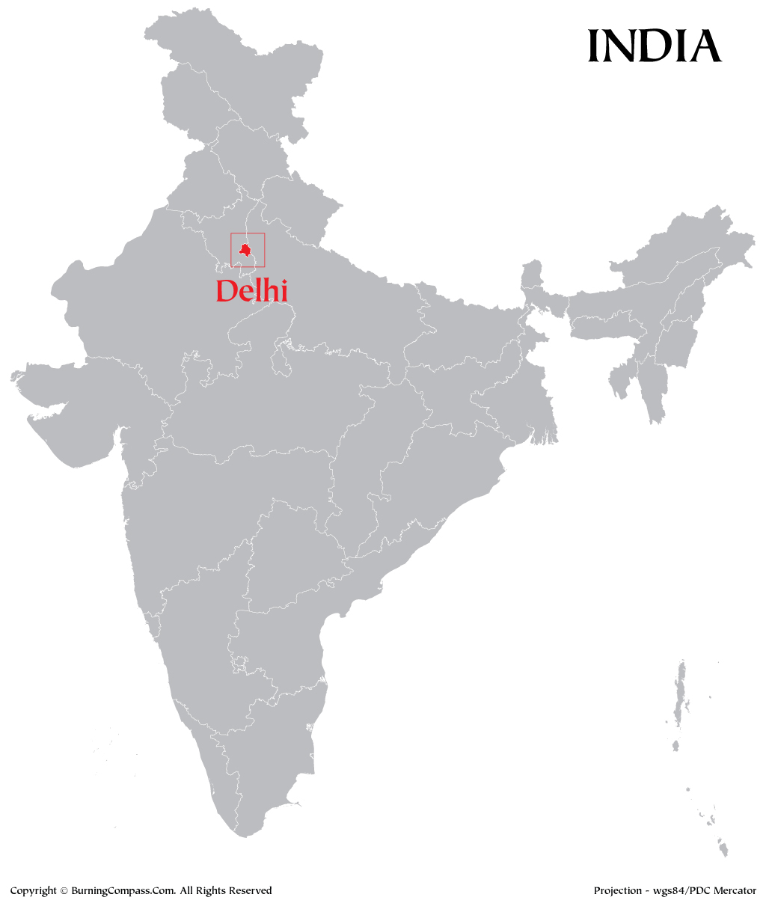
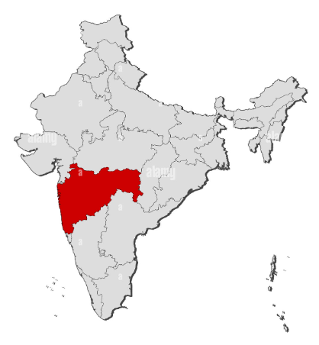
Literature Review
State | Info | Image
Delhi | Delhi is one of the most polluted cities in the world, and air pollution is a major public health concern. According to a study by Singh et al. (2020), the AQI in Delhi exceeds the safe limits for most of the year, with particulate matter being the major pollutant. The study suggests that urgent measures are needed to reduce air pollution in Delhi.
Maharashtra | Maharashtra is one of the most industrialized states in India, and air pollution is a major concern. According to a study by More et al. (2018), the AQI in Maharashtra exceeds the safe limits for most of the year, with particulate matter being the major pollutant. The study suggests that stricter regulations are needed to reduce air pollution in Maharashtra.
21MDT0041 Palak Goel Master Thesis
7

Slide 8
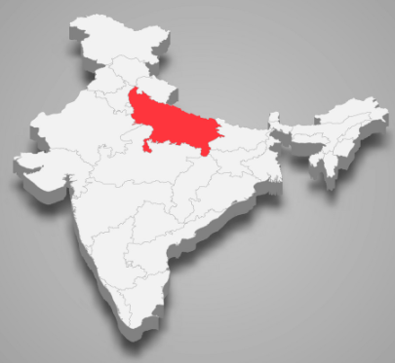
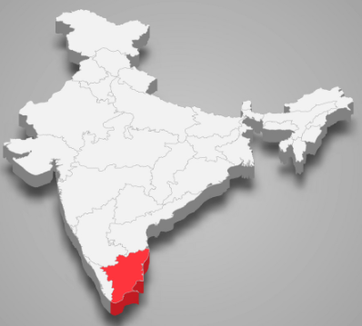
Literature Review
State | Info | Image
Uttar Pradesh | Uttar Pradesh is one of the most populous states in India, and air pollution is a major concern. According to a study by Srivastava et al. (2021), the AQI in Uttar Pradesh exceeds the safe limits for most of the year, with particulate matter being the major pollutant. The study suggests that urgent measures are needed to reduce air pollution in Uttar Pradesh.
Tamil Nadu | Tamil Nadu is one of the least polluted states in India, and air quality is generally good. According to a study by Ravindra et al. (2018), the AQI in Tamil Nadu is below the safe limits for most of the year, with particulate matter being the major pollutant. The study suggests that Tamil Nadu's success in maintaining good air quality can be attributed to its effective policies and regulations.
21MDT0041 Palak Goel Master Thesis
8

Slide 9
Related Work
Sr. No. | Paper | Review
1. | Anikender Kumar, PramilaGoyal, 2011 | Forecast Delhi AQI using MLR and Principal component analysis
2. | Huixiang Liu et al. 2019 | Evaluate AQI for Beijing and Italian for the period of December 2013 to August 2018 with 1738 instances public using SVR and Random Forest
3. | Ziyue Guan and Richard O. Sinnot, 2018 | Predicted the PM2.5 concentration using a variety of machine learning techniques using Artificial Neural Network (ANN), Linear Regression (LR), and Long Short Term Memory (LSTM) recurrent neural networks were utilised as machine learning methods for the PM2.5 prediction.
4. | HeidarMaleki et al. 2019 | Evaluate for the stations Naderi, Havashenasi, MohiteZist and Behdasht in Ahvaz, Iran, the most polluted city in the world AQI and AQHI, from August 2009 to August 2010, they employed an Artificial Neural Network (ANN) machine learning method.
5. | Aditya C. R. et al. 2018 | Forecasted the PM2.5 concentration for a specific day [10]. First, they use the Logistic Regression method to categorise the air as being contaminated or not
6. | S. Tikhe Shruti et al. 2013 | ..\Desktop\LITERATURE SURVEY.docx
21MDT0041 Palak Goel Master Thesis
9

Slide 10
Related Work
Sr. No. | Paper | Review
7. | Nidhi Sharma et al. 2018 | ..\Desktop\LITERATURE SURVEY.docx
8. | Mohamed Shakir and N. Rakesh 2018 | ..\Desktop\LITERATURE SURVEY.docx
9. | Kazem Naddaf et al., 2012 | ..\Desktop\LITERATURE SURVEY.docx
10. | Yusef Omidi Khaniabadi et al.2016 | ..\Desktop\LITERATURE SURVEY.docx
11. | R. Gunasekaran et al. 2012 | ..\Desktop\LITERATURE SURVEY.docx
12. | ArchontoulaChaloulakou et al., 2003 | ..\Desktop\LITERATURE SURVEY.docx
21MDT0041 Palak Goel Master Thesis
10

Slide 11
Work Plan
Extracting the data from government website (i.e. https://cpcb.nic.in/)
Converting the data into csv format
Calculating the sub-indexes of different pollutants
Statistical analysis of pollutants using Anova
Automating the AQI Evaluation using python
Categorising AQI as good, moderate , hazardous…
Training the model using different Machine learning algorithms
Predicting the air quality using trained model
Hotspot Analysis using SaTScan.
21MDT0041 Palak Goel Master Thesis
11

Slide 12
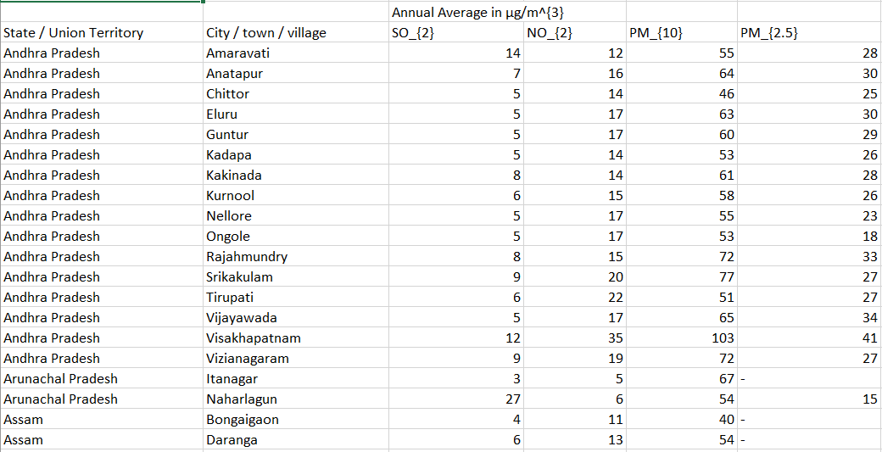

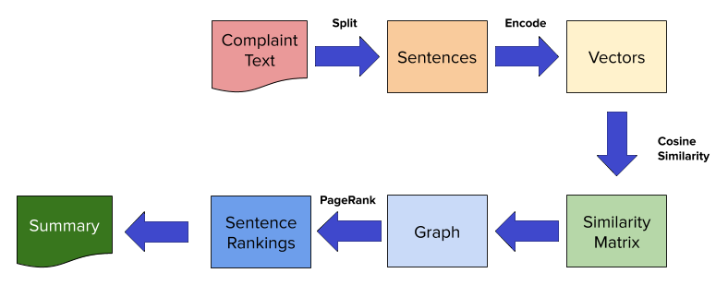

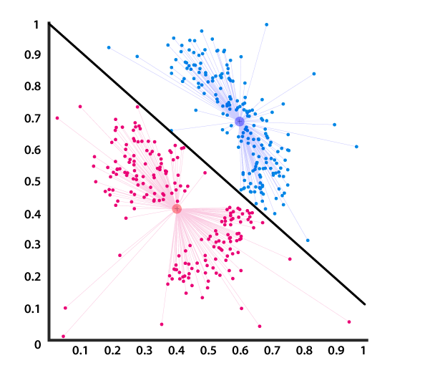
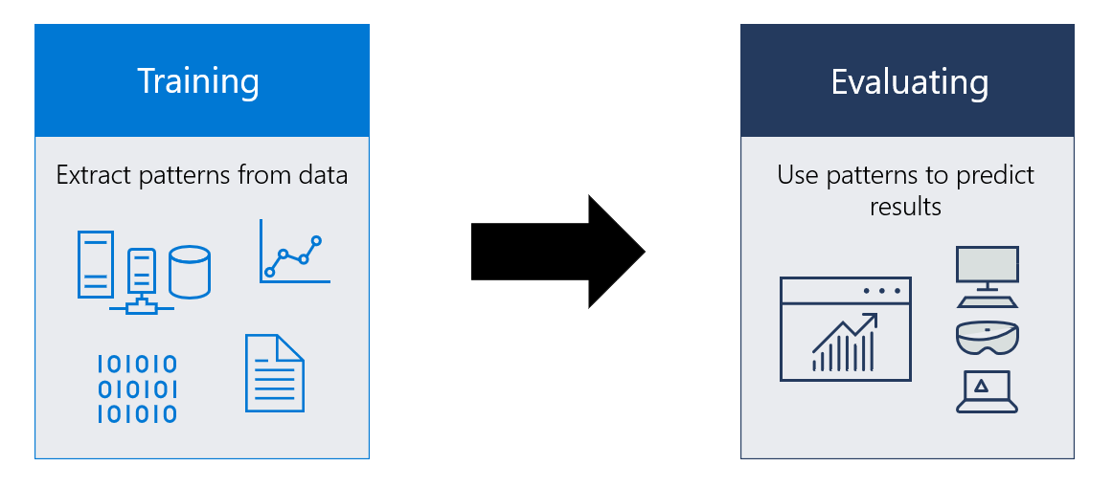
Work Plan
21MDT0041 Palak Goel Master Thesis
12

Slide 13
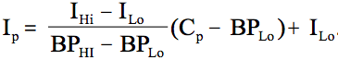
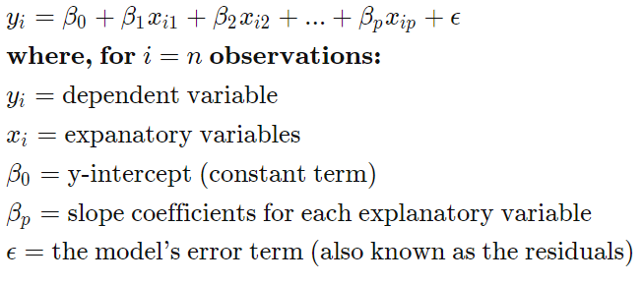
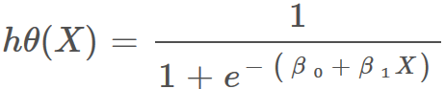
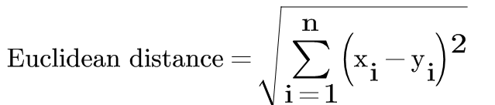
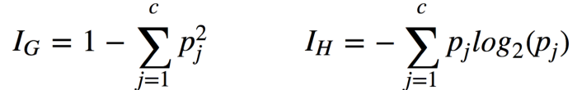
Methodology
AQI Formulation:
Machine Learning Algorithm:
Multiple Linear Regression:
Logistic Regression:
K Nearest Neighbour:
Decision Tree:
SaTScan for clustering and hotspot analysis
21MDT0041 Palak Goel Master Thesis
13

Slide 14

Methodology
Under statistical analysis
One way Anova to study the contribution of air
particulate matter in AQI level,
Correlation Analysis for the judgement of
multicollinearity
Treating missing values by using imputation or
ffill, bfill.
21MDT0041 Palak Goel Master Thesis
14

Slide 15
Software Requirements
Software
Framework
Anaconda Navigator (v3.9)
Jupyter Notebook (v5.2)
SaTScan (v10.1)
Power BI (vDesktop)
NumPy
Pandas
Matplotlib
Seaborn
SkLearn
TensorBoard
21MDT0041 Palak Goel Master Thesis
15

Slide 16
Thank You
By: Guide:
Palak Goel (21MDT0041) Dr. Jitendra Kumar (15975)
MSc. Data Science
School of Advanced Sciences
Vellore Institute of Technology, Vellore
16

